Slide 1
PythonDayEight -exception handling
PoHanWu
20190206

Slide 2
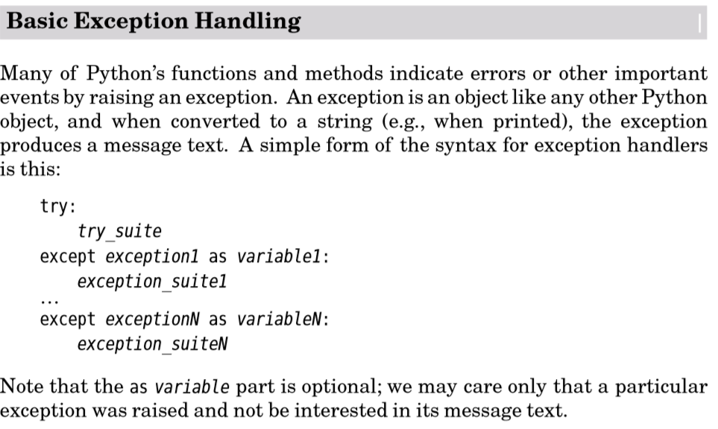

Slide 3

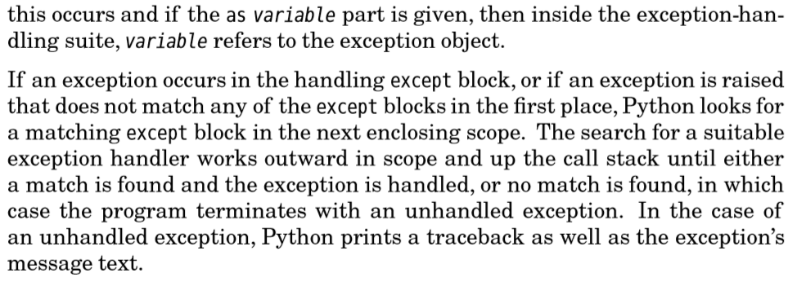

Slide 4
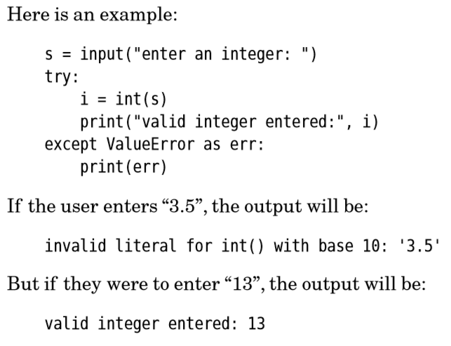


Slide 5

CONCLUSION

